Slide 1


INVERSE KINEMATICS CONTROLLER
Project #4
Prof. Paolo Augusto
BY/ Husam Nujaim

Slide 2
Block Diagram
Initial Configuration (q)
Trapezoidal Velocity Profile
Denavit–Hartenberg Table
Direct Kinematics
Desired Position & Rotation
Transformation Matrix
q
Update Position & Rotation
Error
Jacobean
Joint Velocities (Inv(J)*Error)
Euler integration

Slide 3

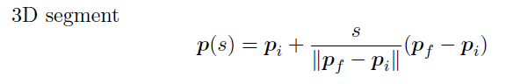
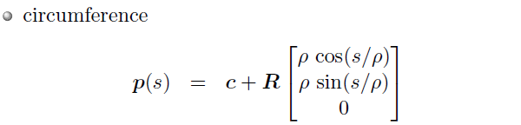
Key Formulas
Exercise 1:
RotMatZ = [cos(pi) -sin(pi) 0
sin(pi) cos(pi) 1
0 0 1]
Exercise 2: (Trapezoidal Velocity Profile)
Exercise 3: (Trapezoidal Velocity Profile)

Slide 4
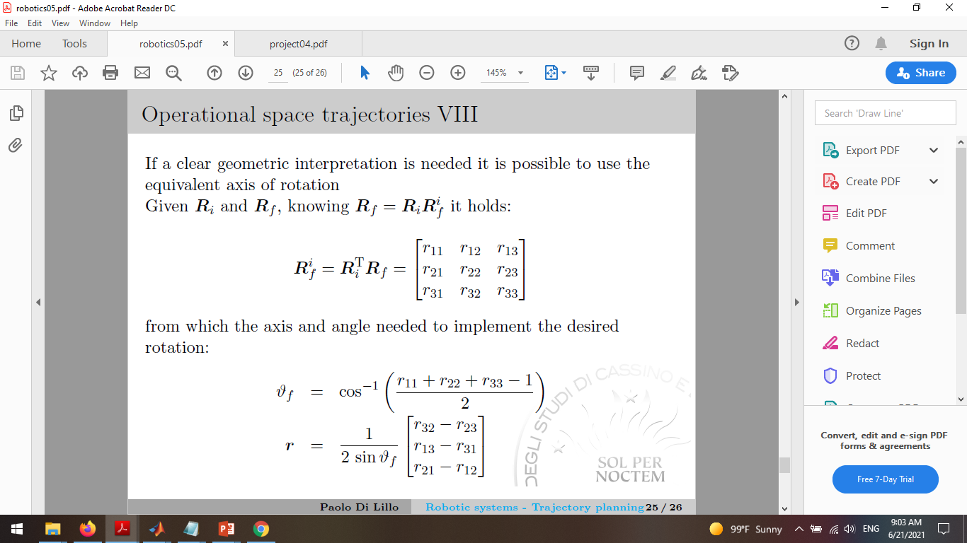
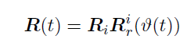
Exercise 4: (Trapezoidal Velocity Profile)
Position
Orientation
Axes-Angle

Slide 5
Grazie Mille
Husam Nujaim

